Slide 1

September 30th 2020
Quality Assessment and Analysis of Steps Data
Chris Moore
Department of Epidemiology
University of North Carolina at Chapel Hill

Slide 2

Outline
Why steps?
Data quality assessment in HCHS/SOL
Translating between counts and steps
Future directions

Slide 3
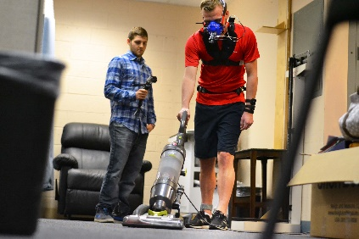
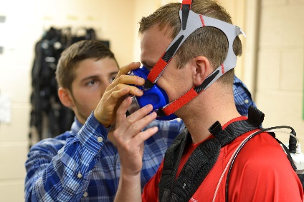
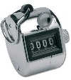




But first…
Department of Epidemiology
2018
2016
2019

Slide 4
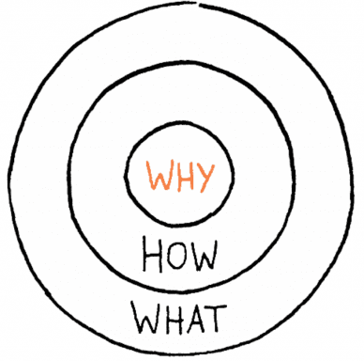
Why Steps?
Short answer - because the public likes them
Long answer – steps are:
Simple
Observable
Accessible
Most consumer wearable devices
count steps¹
Based on fewer assumptions
Compared to distance or EE from the same device²
Golden Circle
Simon Sinek, Start with Why 2011
¹The State of Wearables Today Consumer Survey. Valencell Inc, 2018
²Crouter et al. Med Sci Sports Exerc, 2003

Slide 5
Why Steps?
Part G: Needs for Future Research
Question 1) Step Count Per Day
Conduct additional longitudinal research… to examine the dose-response relationship between steps per day and health outcomes.
… examine whether the rate of stepping and the length (bouts) of continuous steps influences the relationship between steps per day and disease outcomes
Notes:
Since this time, some growing interest in examining how steps related to health outcomes

Slide 6







In Pursuit of Consistency & Transitivity
Lots of data on accelerometer counts ~ health
2019
Notes:
Step-based recommendations should be consistent with prior literature
May be some utility in trying to translate this research to steps
However, a complementary approach may be to examine how step-based metrics correspond to PA levels from self-report and activity counts and thus, by transitivity, enable step-based recommendations to also be informed by the full body of literature on PA and health

Slide 7
Study Overview
Hispanic Community Health Study / Study of Latinos
Prospective cohort study
Population-based sample of Hispanic/Latino adults
This analysis
Baseline data only
Specific Aims:
0. Identify problematic data (i.e. device malfunctions)
Describe step-based metric distributions
Quantify associations b/w step-based metrics vs counts & self-report
Calibrate preliminary step-based translations of US national PA guidelines

Slide 8
HCHS/SOL Methods

Slide 9
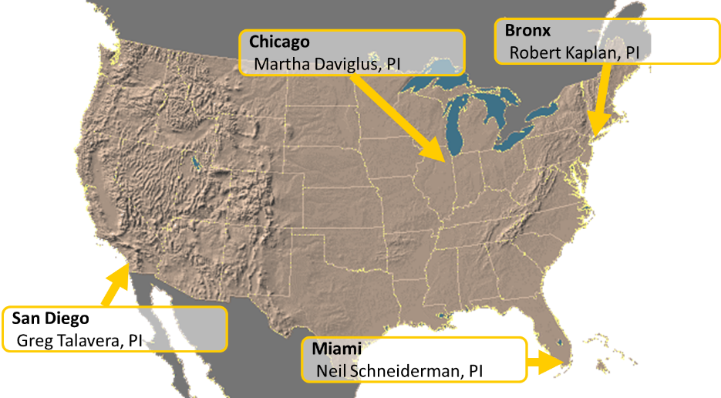

Study Sample
Hispanic Community Health Study / Study of Latinos
16,415 Latino adults in the US
Baseline assessments in 2008-2011
Including accelerometry¹
¹Evenson et al. MSSE 2015

Slide 10
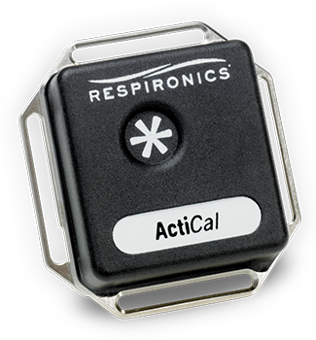
Measures & Procedures
Actical accelerometer (version B-1; model 198-0200-03)
“Omnidirectional”
Waist-worn
One week during waking hours
1-min epochs
Non-wear – Choi algorithm
Adherence: ≥3 days of ≥10 hrs
Actical count cut points^{1,2}
PA Intensity | Cutpoint (counts)
Sedentary | <100 counts/min
Light | 100-1534 counts/min
Moderate | 1535-3961 counts/min
Vigorous | ≥3962 counts/min
1) Colley et al. Health Rep 2011
2) Wong et al. J Phys Act Health 2011
Notes:
Waist cut points developed in adults
Chen KY, Bassett DR, Jr. The technology of accelerometry-based activity monitors: current and future. Med Sci Sports Exerc. 2005;37(11 Suppl):S490-500.
Piezoelectric sensor principles and properties.
Most accelerometry-based PA monitors use one or multiple piezoelectric accelerometers. A piezoelectric acceleration sensor consists of a piezoelectric element and a seismic mass, housed in an enclosure (Fig. 1). When the sensor undergoes acceleration, the seismic mass causes the piezoelectric element to experience deformation in the forms of bending (in beam sensors) or direct tension or compression (in the newer integrated chip (IC) sensors). These conformational changes cause displaced charge to build up on one side of the sensor, which can generate a variable output voltage signal that is proportional to the applied acceleration. In the case of a beam configuration, the piezoelectric element is the most sensitive in the bending direction; hence it is often referred to as uniaxial. However, deformations in other directions or planes can also results in acceleration signals. Some define this type of piezoelectric sensor as omnidirectional, which means it senses accelerations not only in the axis of bending (e.g., vertical to ground), but also the other planes or directions (horizontal and lateral). Furthermore, the difference in sensitivity in each direction is determined by the geometry (cross-sectional area and length), material property (stiffness), and the positioning of the seismic mass on its beam. In fact, all piezoelectric beam accelerometers have various degrees of such omnidirectional effect. The output from these accelerometers combines signals from all directions, while the contributions from each direction are not differentiable.

Slide 11
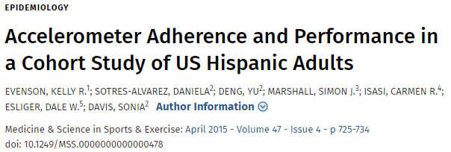
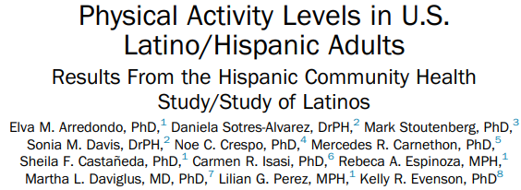

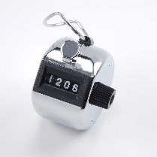


PA Based on Counts
Mid-2019
2015

Slide 12
Steps Data Quality Assessment

Slide 13
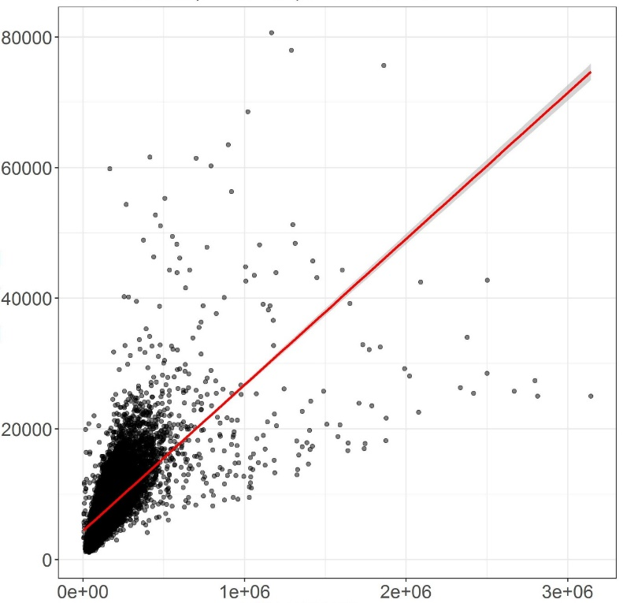
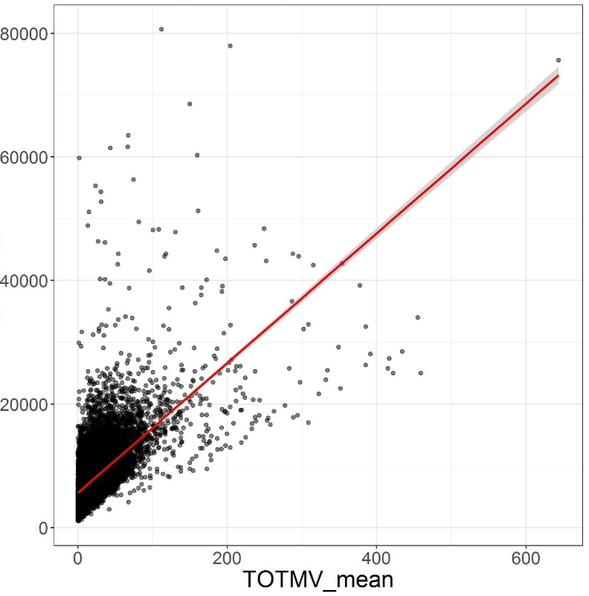
A First Look…
Mile: Milia passuum = 1,000 strides = 2,000 steps
?
X
30 miles(ish…)
Steps/Day
Amish men¹
(Yamax SW-200)
Counts/Day
MVPA Min/Day
¹Bassett et al. Med Sci Sports Exerc. 2004
Notes:
30 miles = ~50 km

Slide 14
A First Look…
X
Steps/Day
Counts/Day
MVPA Min/Day

Slide 15
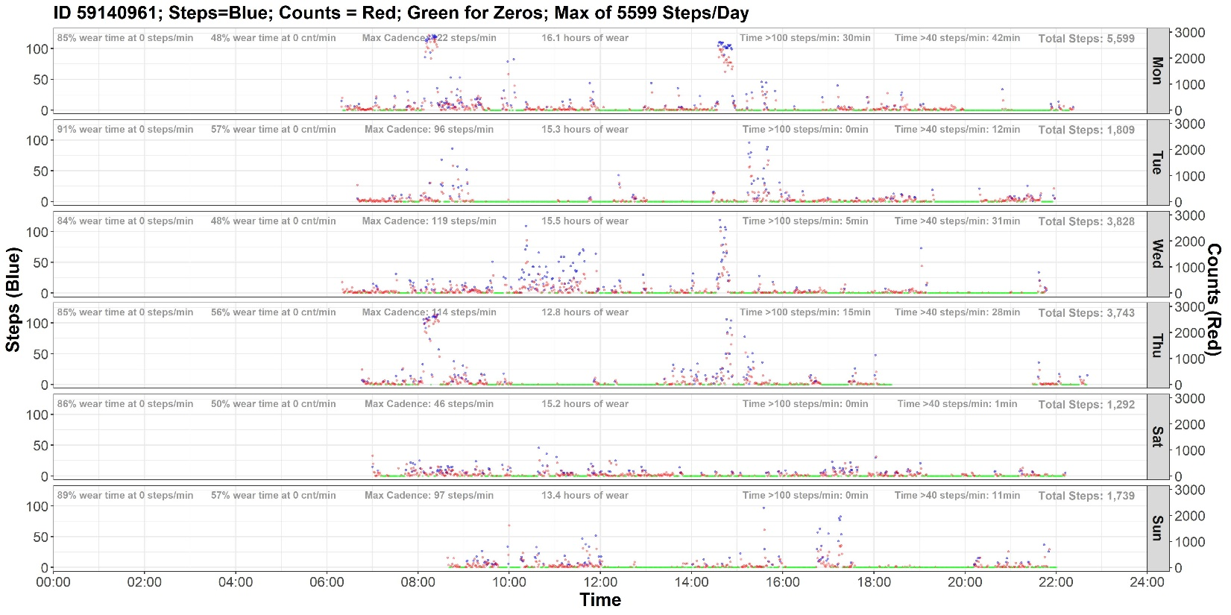
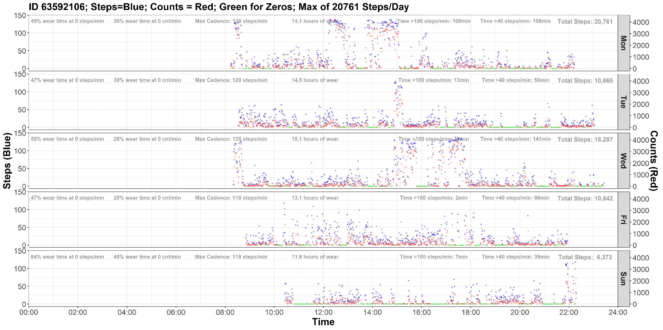
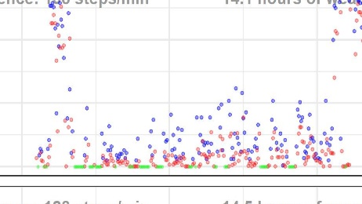
Example: What We Would Expect
X
Steps Counts
^Both^ zero

Slide 16
Example: What We Would Expect

Slide 17
A First Look…
Mile: Milia passuum = 1,000 paces (strides) = 2,000 steps
X
Steps/Day
Counts/Day
MVPA Min/Day

Slide 18
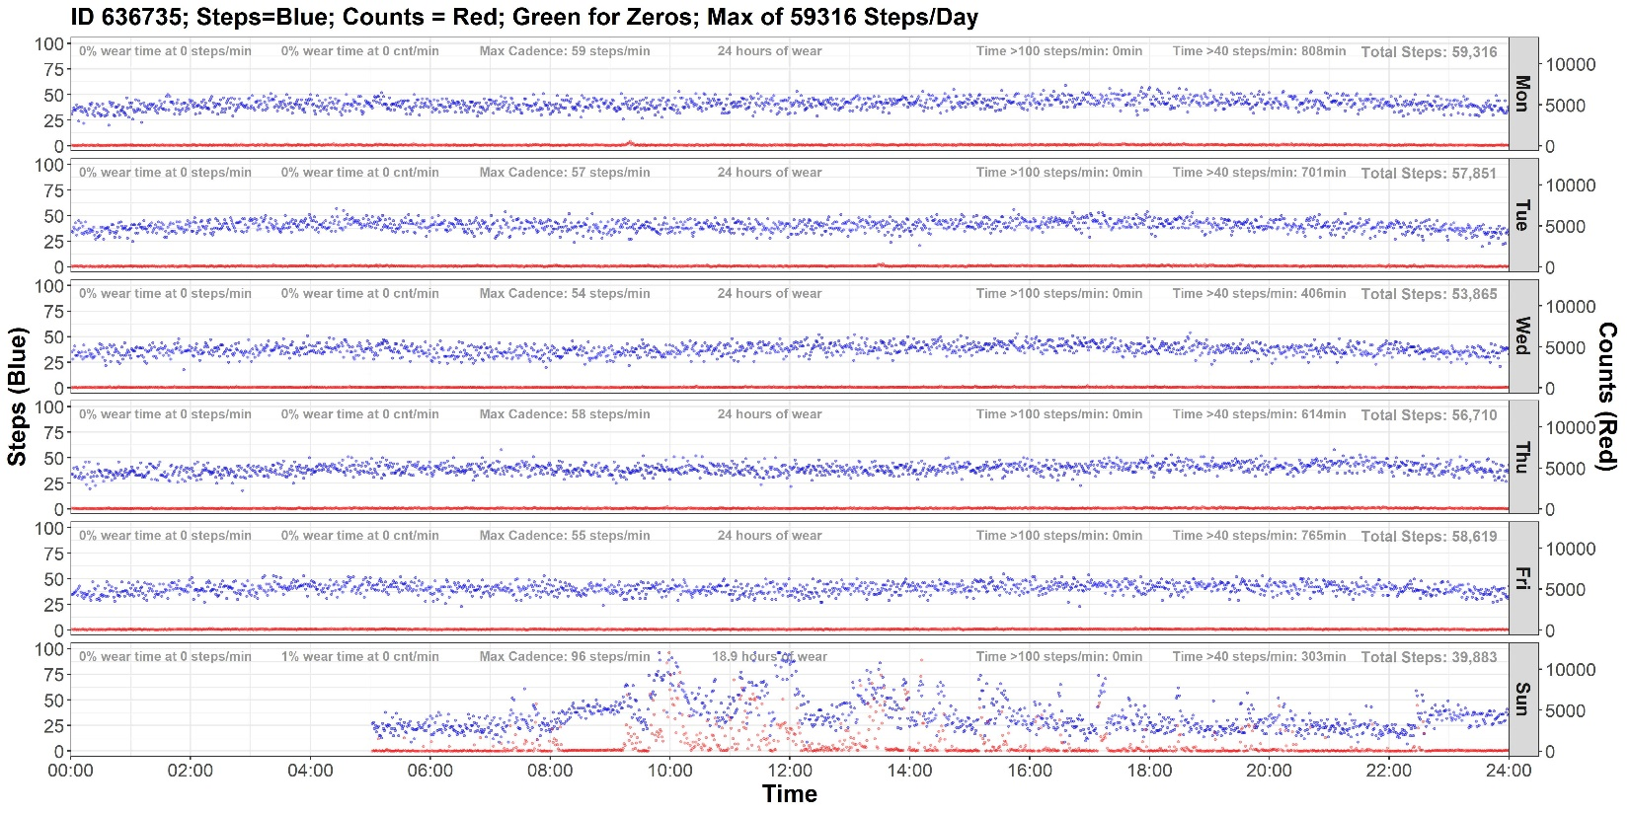
Huh?
Y-limit set to max count value of the week
First wear day
Notes:
Hovering around 40

Slide 19
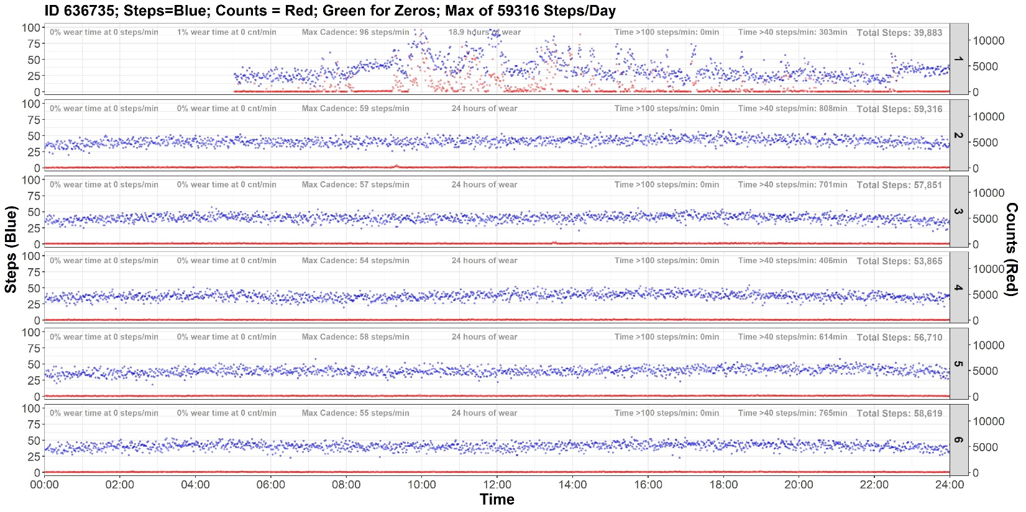
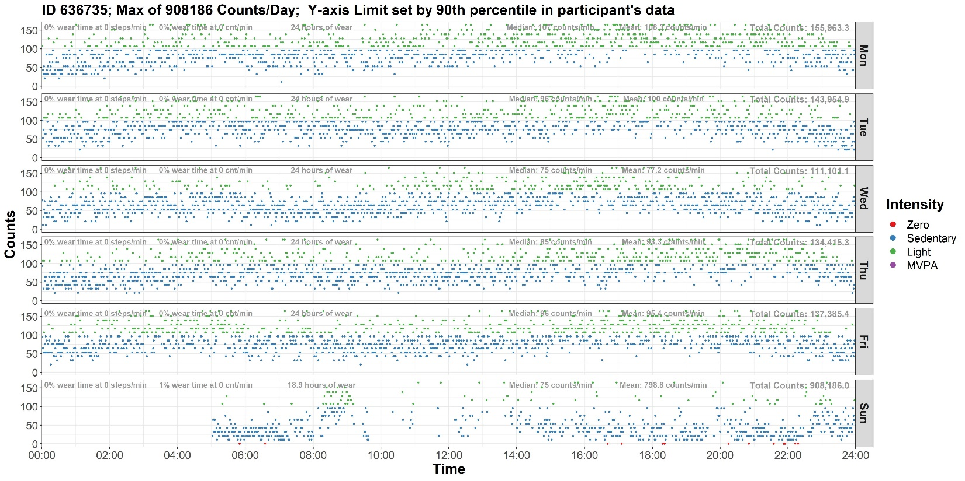
Huh?
(same ID, but focusing on counts)

Slide 20
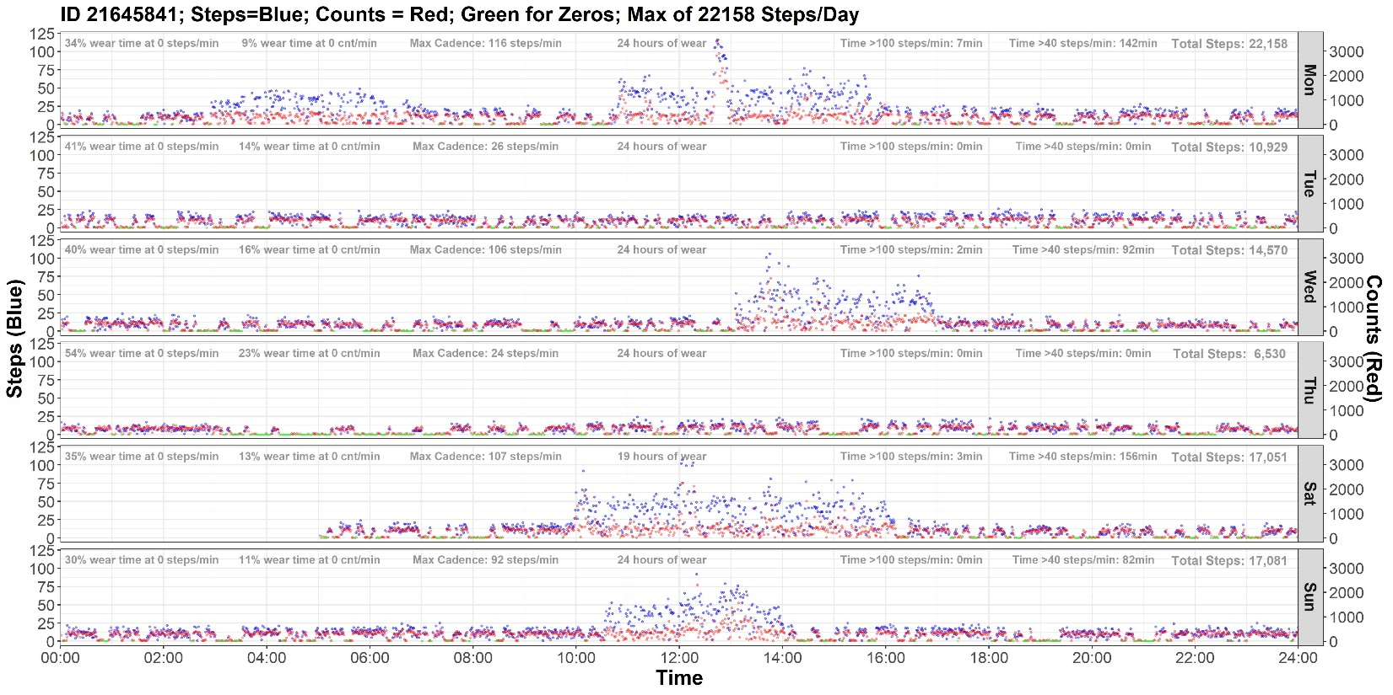
Huh?
Another example
X
First wear day
Notes:
Weird pattern

Slide 21
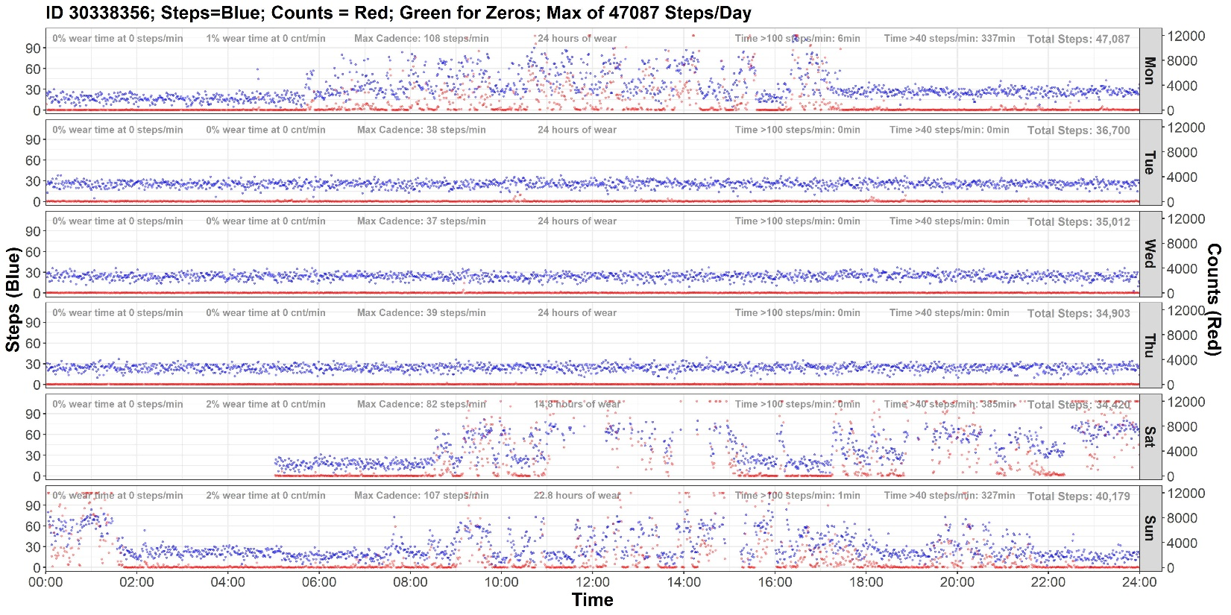
Huh?
Another ‘nother example
X
First wear day
Notes:
Additive with activity

Slide 22
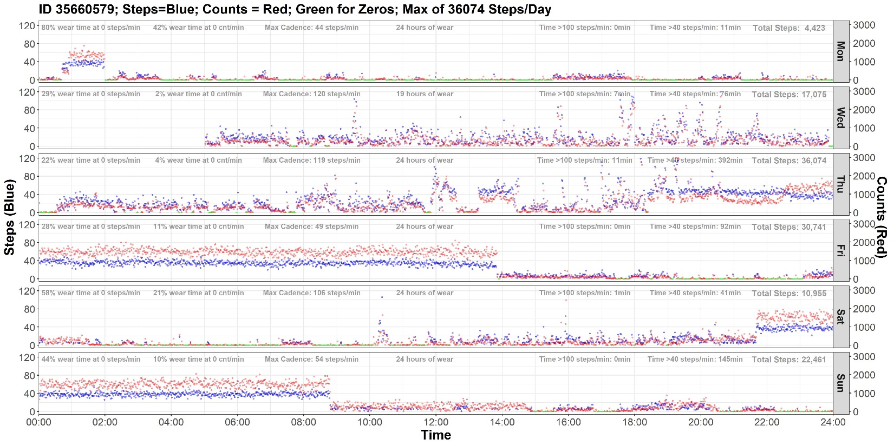
Huh?
Another ‘nother ‘nother example
Notes:
Something went wrong and then not

Slide 23
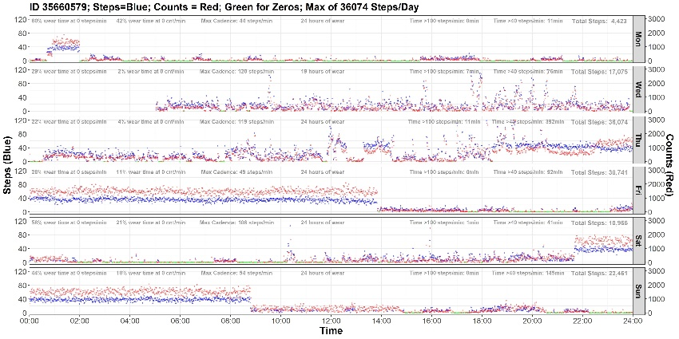


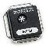


Why?
After speaking to an Actical representative…
Plan A: Check device reset indicator
Flag values >15
Plan B?

Slide 24
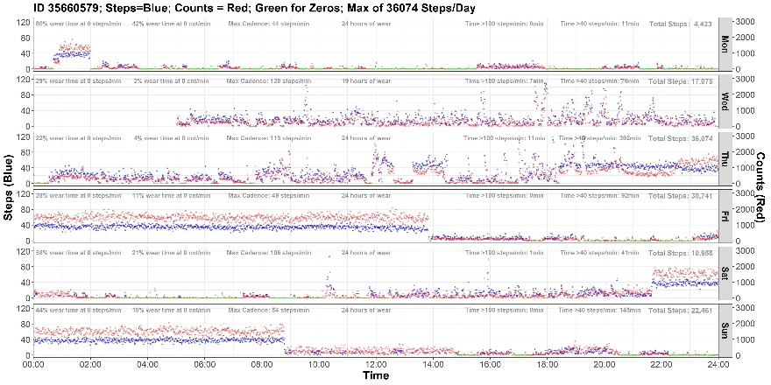

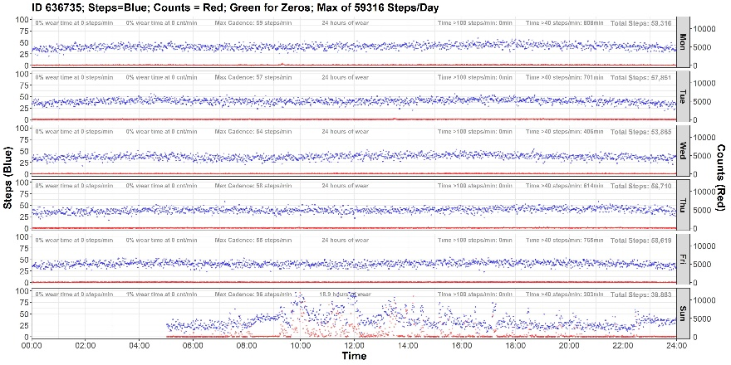
Plan B?
Question:
What would you do?
(n = 12,750)
Steps/Day
MVPA Min/Day

Slide 25
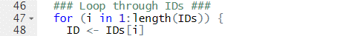
What I Did…
. . .
. . .
. . .

Slide 26
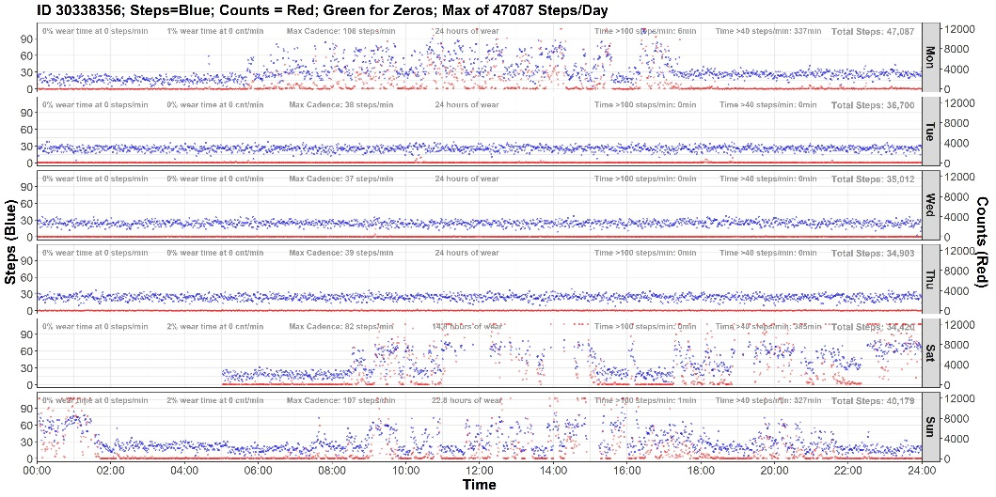
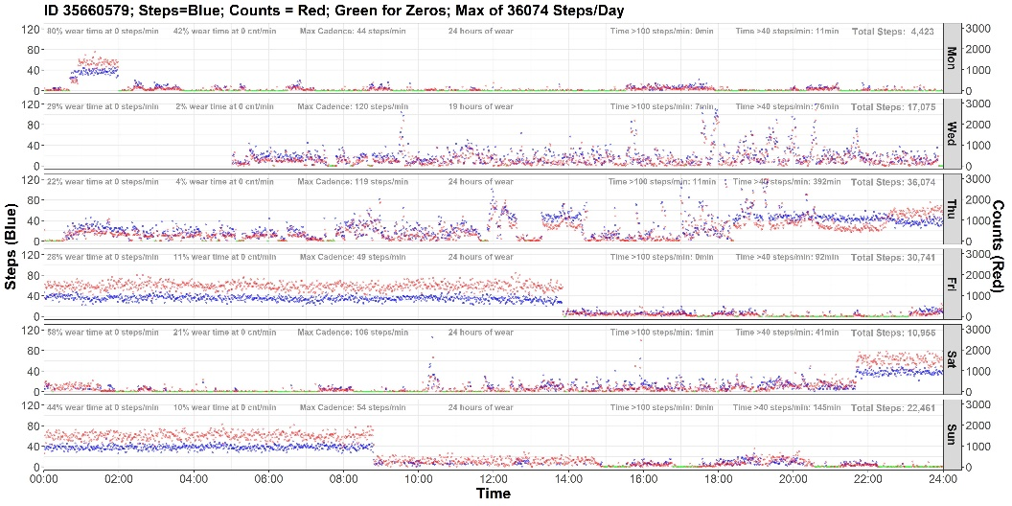
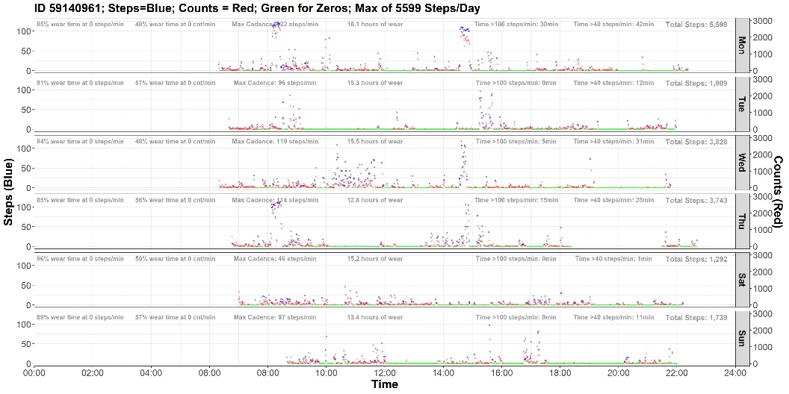
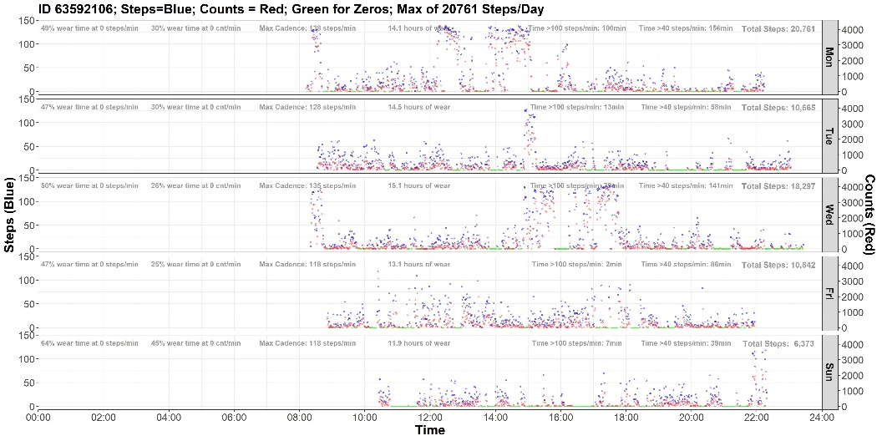
Visual Inspection: Our “Criterion”

Slide 27

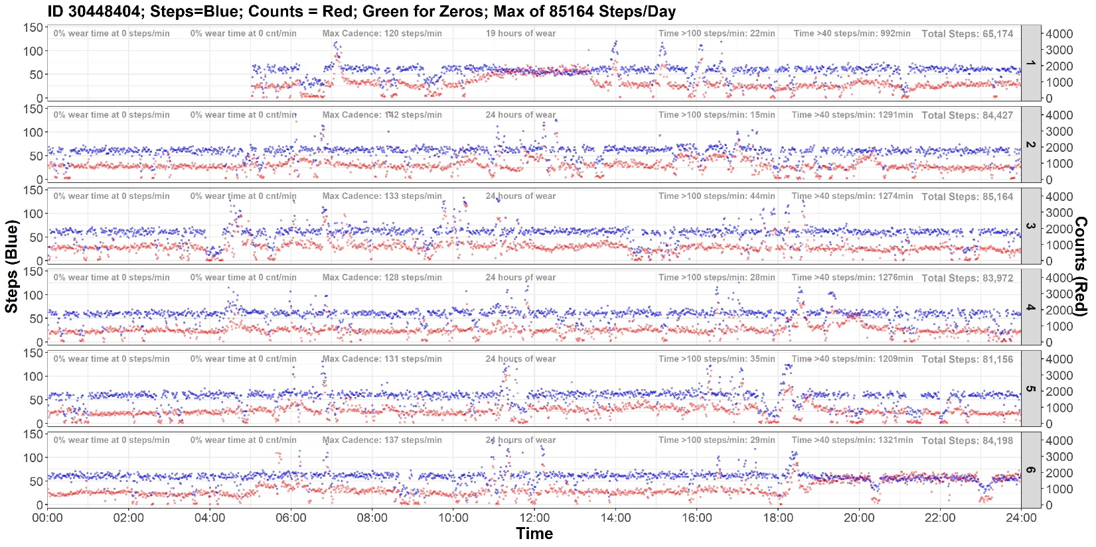

Is it valid data?
Valid data
Potential malfunction

Slide 28
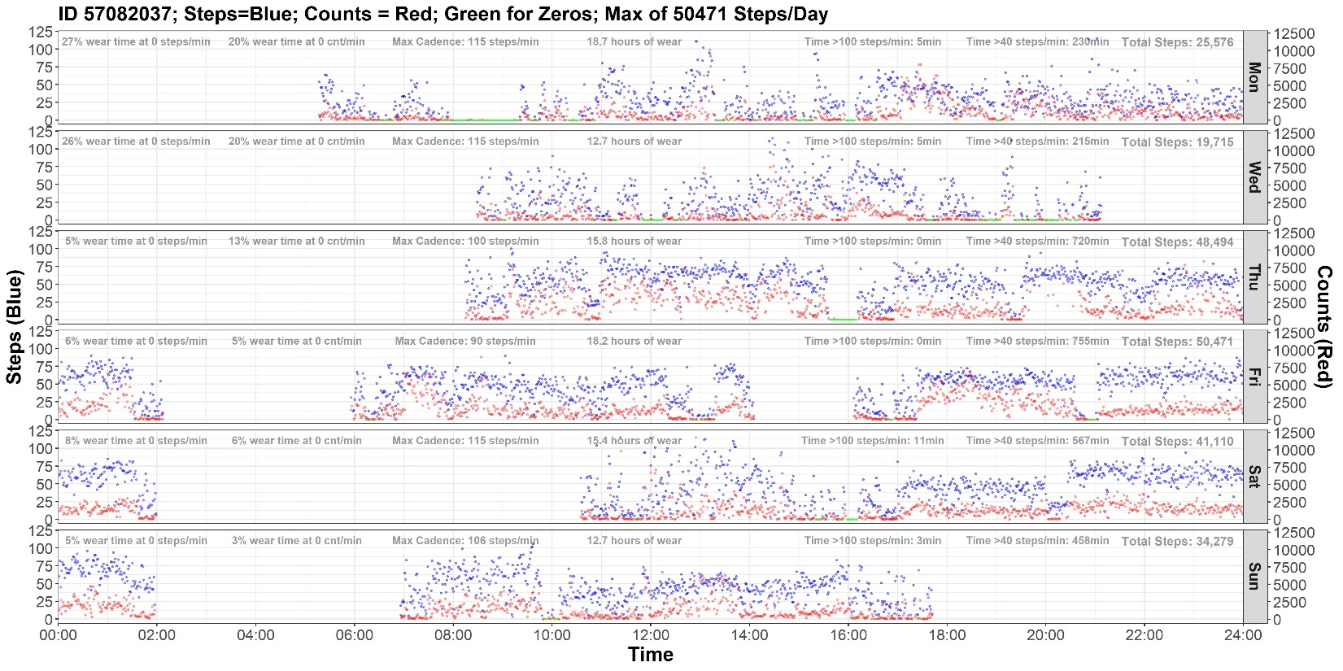
Is it valid data?
Notes:
Can definitely look for high steps, but this person just seems very active

Slide 29
Is it valid data?
Notes:
Don’t have crazy high steps. But they don’t sleep

Slide 30
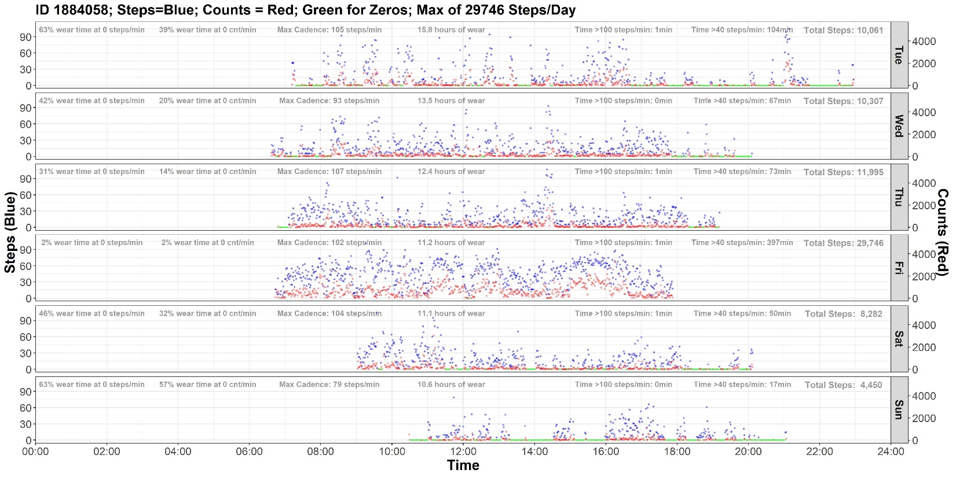
Is it valid data?
Notes:
Active during all wear, pretty high steps. But they sleep

Slide 31
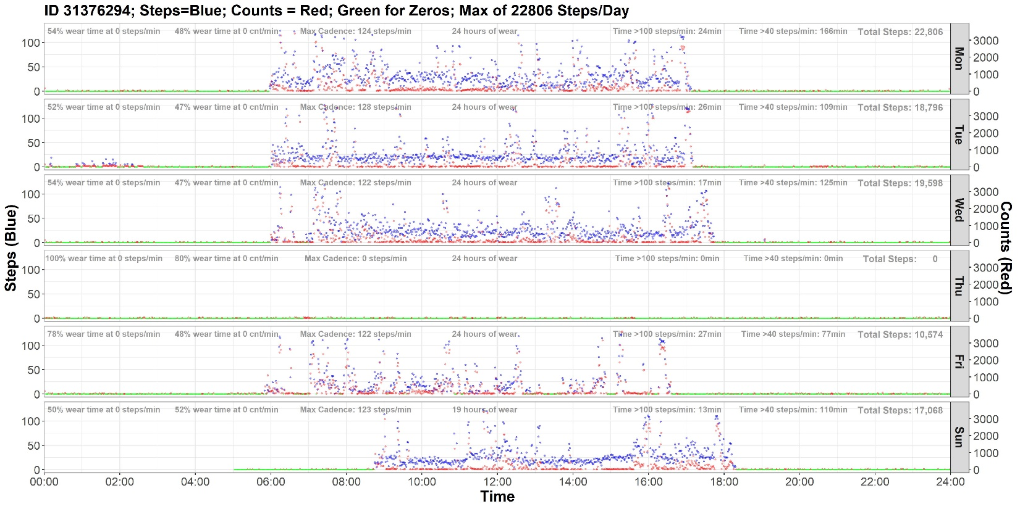
Is it valid data?
Notes:
They sleep, but looks like Choi didn’t pick-up on it
So not as easy as wear time

Slide 32
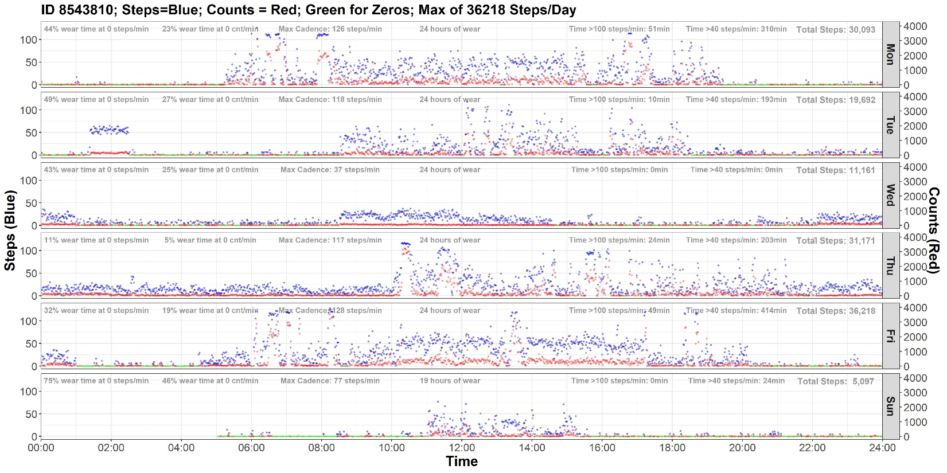
Is it valid data?
But not too hard right?
Notes:
Harder one
I think Thursday was a malfunction

Slide 33
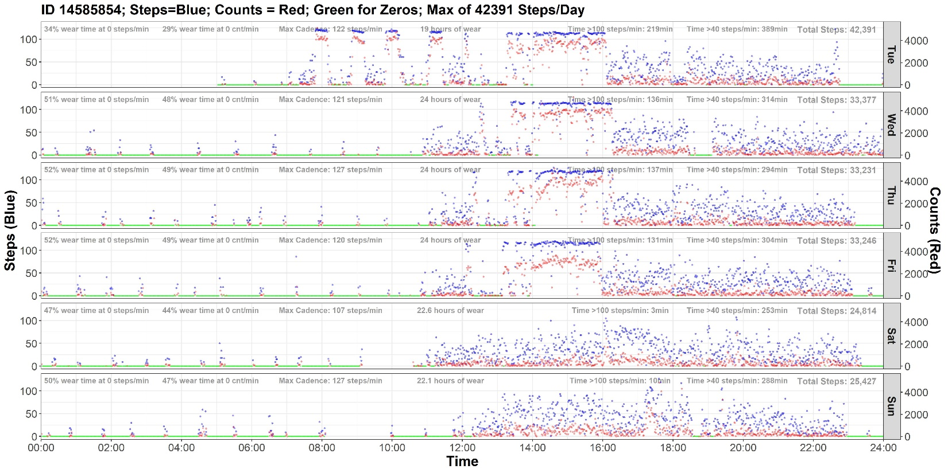
Is it valid data?
Notes:
Harder one

Slide 34
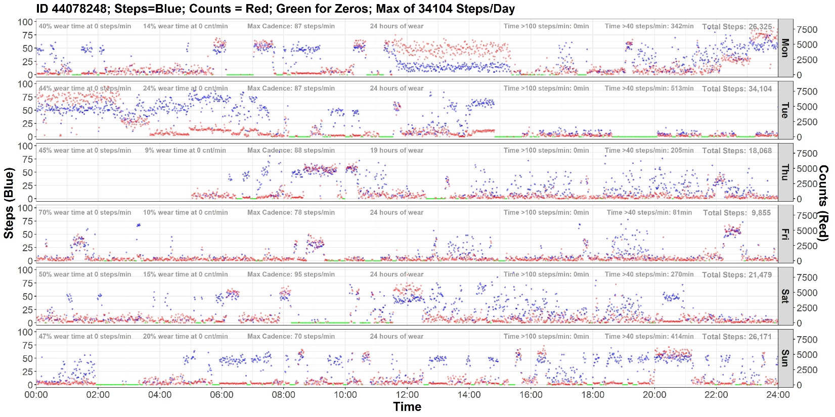
Is it valid data?

Slide 35
What I Did…
. . .
How long does it take to look through 100?
. . .
. . .

Slide 36
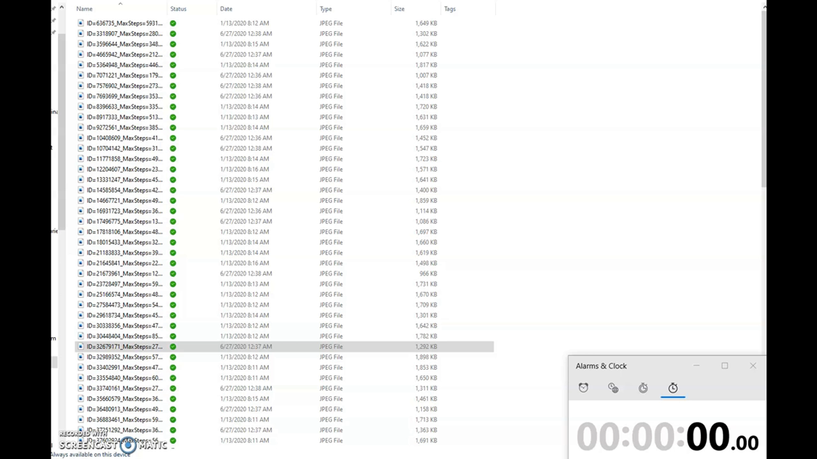
Digging in… n = 100

Slide 37
An Iterative Process…
1) Some arbitrary flagging criteria
+
2) More refined flagging criteria
+
3) Random forest algorithm
Plots!
Plots!
PLOTS!
Flagging Criteria/Method | n (%) Malfunctions Flagged
≥40,000 steps/day | 49 (74.2%)
≤10% day at 0 steps/min | 52 (78.8%)
≥6 hr bout of consecutive non-zero step/min | 51 (77.3%)
66 participants with device malfunctions
Random forest algorithm | 8 (12.1%)
12 unique Actical IDs

Slide 38
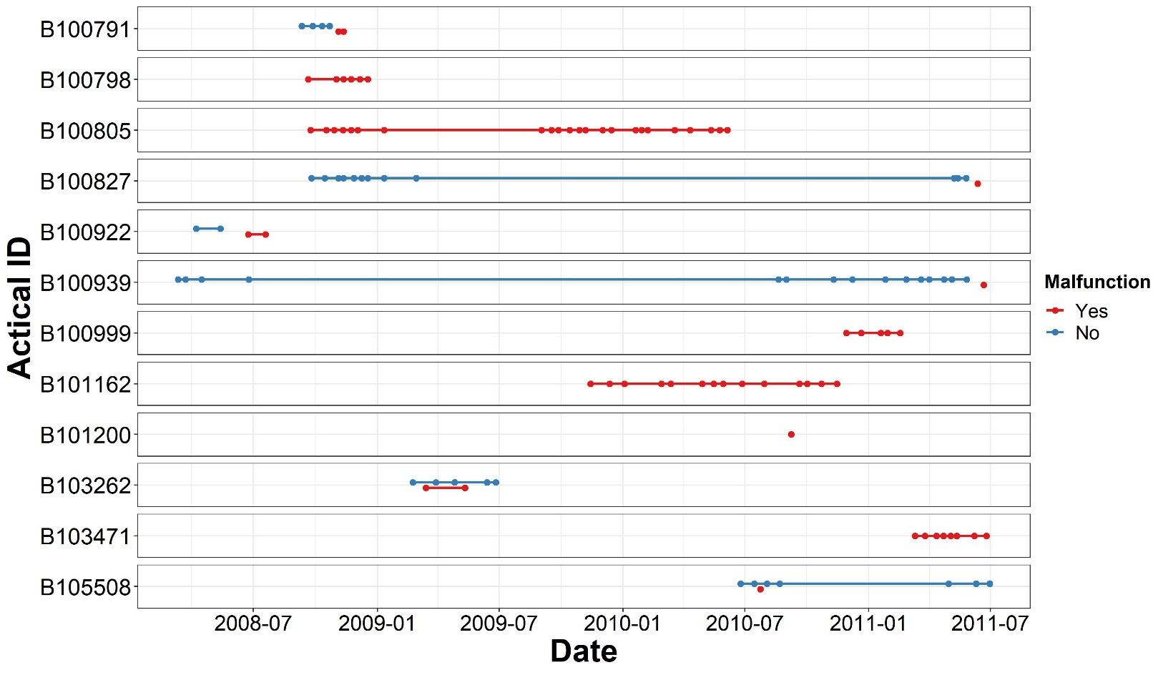
66 IDs - Only 12 Devices

Slide 39
66 IDs - Only 12 Devices
Flagging Criteria/Method | n (%)
≥40,000 steps/day | 49 (74.2%)
≤10% day at 0 steps/min | 52 (78.8%)
≥6 hr bout of consecutive non-zero step/min | 51 (77.3%)
Random forest algorithm | 8 (12.1%)
Same Actical ID | 2 (12.1%)
In Total:
272 participants flagged, plotted, and screened (sort of)
68 participants with device malfunctions
68

Slide 40
Analytic Sample
(unpublished)

Slide 41
Final Sample
Characteristic | n (%)
Original sample (any data) | 14,913 (100%)
Nonadherent | -2,163 (14.5%)
No steps data (all 0 steps/day) | -42 (0.3%)
Device malfunction | -68 (0.5%)
Final sample | 12,640 (84.8%)
68
Notes:
65,932 days

Slide 42
Final Sample
Characteristic | Overall (n=12,640) | Men (n=5,043; 40%) | Women (n=7,597; 60%)
Adherent days (n) | 5.2 (1.0) | 5.3 (1.0) | 5.2 (1.0)
Wear time (hrs/day) | 16.1 (3.0) | 16.4 (3.1) | 15.8 (2.9)
Age (years) | 46.9 (13.6) | 45.8 (14.1) | 47.6 (13.2)
BMI (kg/m²) | 29.7 (5.9) | 28.9 (5.2) | 30.2 (6.23)
≥150 min/week MVPA (self-report; %) | 63.9% | 74.1% | 57.1%
Values presented as mean (SD) unless otherwise indicated *Based on Actical counts
Characteristic | Overall (n=12,640) | Men (n=5,043; 40%) | Women (n=7,597; 60%)
Adherent days (n) | 5.2 (1.0) | 5.3 (1.0) | 5.2 (1.0)
Wear time (hrs/day) | 16.1 (3.0) | 16.4 (3.1) | 15.8 (2.9)
Age (years) | 46.9 (13.6) | 45.8 (14.1) | 47.6 (13.2)
BMI (kg/m²) | 29.7 (5.9) | 28.9 (5.2) | 30.2 (6.23)
≥150 min/week MVPA (self-report; %) | 63.9% | 74.1% | 57.1%
MVPA min/day* | 22.9 (29.6) | 29.9 (33.8) | 18.3 (25.3)
Sedentary hrs/day* | 11.9 (3.0) | 11.9 (3.2) | 11.9 (2.8)
Light PA min/day* | 226.5 (92.2) | 239.0 (101.9) | 218.2 (84.1)
Moderate PA min/day* | 19.9 (21.3) | 25.6 (24.9) | 16.1 (17.6)
Vigorous PA min/day* | 3.0 (12.0) | 4.3 (13.3) | 2.2 (10.9)
Values presented as mean (SD) unless otherwise indicated *Based on Actical counts

Slide 43
Step-Based Metrics
Metric | Definition
Volume indicators
Steps/day | Sum of steps/min accumulated in a day
Peak effort indicators
Peak 30-min cadence | Average steps/min recorded for the 30 highest, but not necessarily consecutive, minutes in a day
Time spent stepping
Min/day at 1–39 steps/min | Time in sporadic movement
Min/day at 1–69 steps/min | Time in non-walking movement
Min/day at ≥40 steps/min | Time in minimally purposeful stepping
Min/day at ≥70 steps/min | Time in minimally slow walking
Min/day at ≥100 steps/min | Time in brisk ambulation
Time in non-movement
Time at zero cadence (TZC) | Time at 0 steps/min

Slide 44
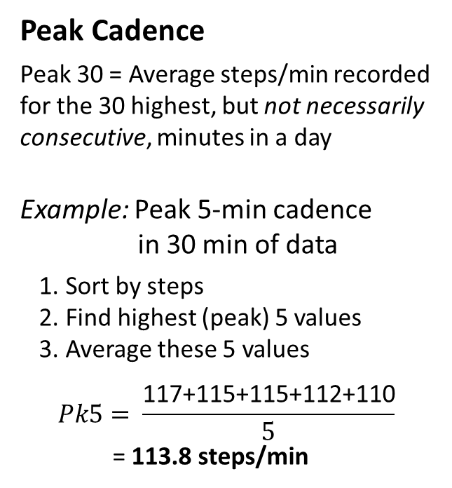
Peak 30-min Cadence
Peak Cadence
Peak 30 = Average steps/min recorded for the 30 highest, but not necessarily consecutive, minutes in a day
Example: Peak 5-min cadence
in 30 min of data
Sort by steps
Find highest (peak) 5 values
Average these 5 values
$$Pk5= \frac{\text{117+115+115+112+110}}{5}$$
= 113.8 steps/min
Time | Steps
0:01:00 | 0
0:02:00 | 0
0:03:00 | 0
0:04:00 | 0
0:05:00 | 12
0:06:00 | 112
0:07:00 | 12
0:08:00 | 0
0:09:00 | 110
0:10:00 | 0
0:11:00 | 36
0:12:00 | 12
0:13:00 | 0
0:14:00 | 0
0:15:00 | 0
0:16:00 | 0
0:17:00 | 115
0:18:00 | 117
0:19:00 | 109
0:20:00 | 96
0:21:00 | 97
0:22:00 | 115
0:23:00 | 93
0:24:00 | 88
0:25:00 | 16
0:26:00 | 11
0:27:00 | 0
0:28:00 | 0
0:29:00 | 94
0:30:00 | 0
Time | Steps
0:01:00 | 0
0:02:00 | 0
0:03:00 | 0
0:04:00 | 0
0:05:00 | 12
0:06:00 | 112
0:07:00 | 12
0:08:00 | 0
0:09:00 | 110
0:10:00 | 0
0:11:00 | 36
0:12:00 | 12
0:13:00 | 0
0:14:00 | 0
0:15:00 | 0
0:16:00 | 0
0:17:00 | 115
0:18:00 | 117
0:19:00 | 109
0:20:00 | 96
0:21:00 | 97
0:22:00 | 115
0:23:00 | 93
0:24:00 | 88
0:25:00 | 16
0:26:00 | 11
0:27:00 | 0
0:28:00 | 0
0:29:00 | 94
0:30:00 | 0
Time | Steps
0:18:00 | 117
0:17:00 | 115
0:22:00 | 115
0:06:00 | 112
0:09:00 | 110
0:19:00 | 109
0:21:00 | 97
0:20:00 | 96
0:29:00 | 94
0:23:00 | 93
0:24:00 | 88
0:11:00 | 36
0:25:00 | 16
0:05:00 | 12
0:07:00 | 12
0:12:00 | 12
0:26:00 | 11
0:01:00 | 0
0:02:00 | 0
0:03:00 | 0
0:04:00 | 0
0:08:00 | 0
0:10:00 | 0
0:13:00 | 0
0:14:00 | 0
0:15:00 | 0
0:16:00 | 0
0:27:00 | 0
0:28:00 | 0
0:30:00 | 0
Time | Steps
0:18:00 | 117
0:17:00 | 115
0:22:00 | 115
0:06:00 | 112
0:09:00 | 110
0:19:00 | 109
0:21:00 | 97
0:20:00 | 96
0:29:00 | 94
0:23:00 | 93
0:24:00 | 88
0:11:00 | 36
0:25:00 | 16
0:05:00 | 12
0:07:00 | 12
0:12:00 | 12
0:26:00 | 11
0:01:00 | 0
0:02:00 | 0
0:03:00 | 0
0:04:00 | 0
0:08:00 | 0
0:10:00 | 0
0:13:00 | 0
0:14:00 | 0
0:15:00 | 0
0:16:00 | 0
0:27:00 | 0
0:28:00 | 0
0:30:00 | 0
Sort by
steps
Notes:
Sorted by time → sorted by steps

Slide 45
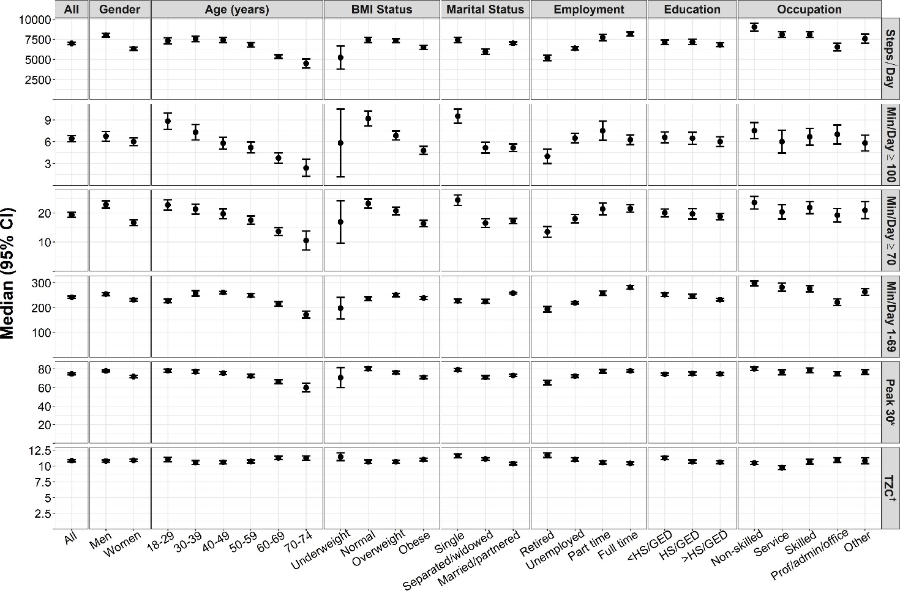
Distributions of Step-Based Metrics
All values were standardized to U.S. 2010 Census Population and weighted for survey design, nonresponse, and missing accelerometer data
Min/day ≥40 = daily mins ≥40 steps/min; Min/day ≥70 = daily mins ≥70 steps/min; Min/day ≥100 = daily mins ≥100 steps/min
*Peak 30-min cadence; Units are steps/min
†Daily time at zero cadence (0 steps/min) adjusted for wear time; Units are hours/day
Notes:
Participants accumulated a median of ~7,000 steps/day,
-Spent medians of approximately
6 mins/day at ≥100 steps/min,
20 min/day at ≥70 steps/min,
4 hours/day at 1-69 steps/min,
- Had a median peak 30-min cadence of ~75 steps/min,
-Spent ~11 hours/day at 0 steps/min

Slide 46
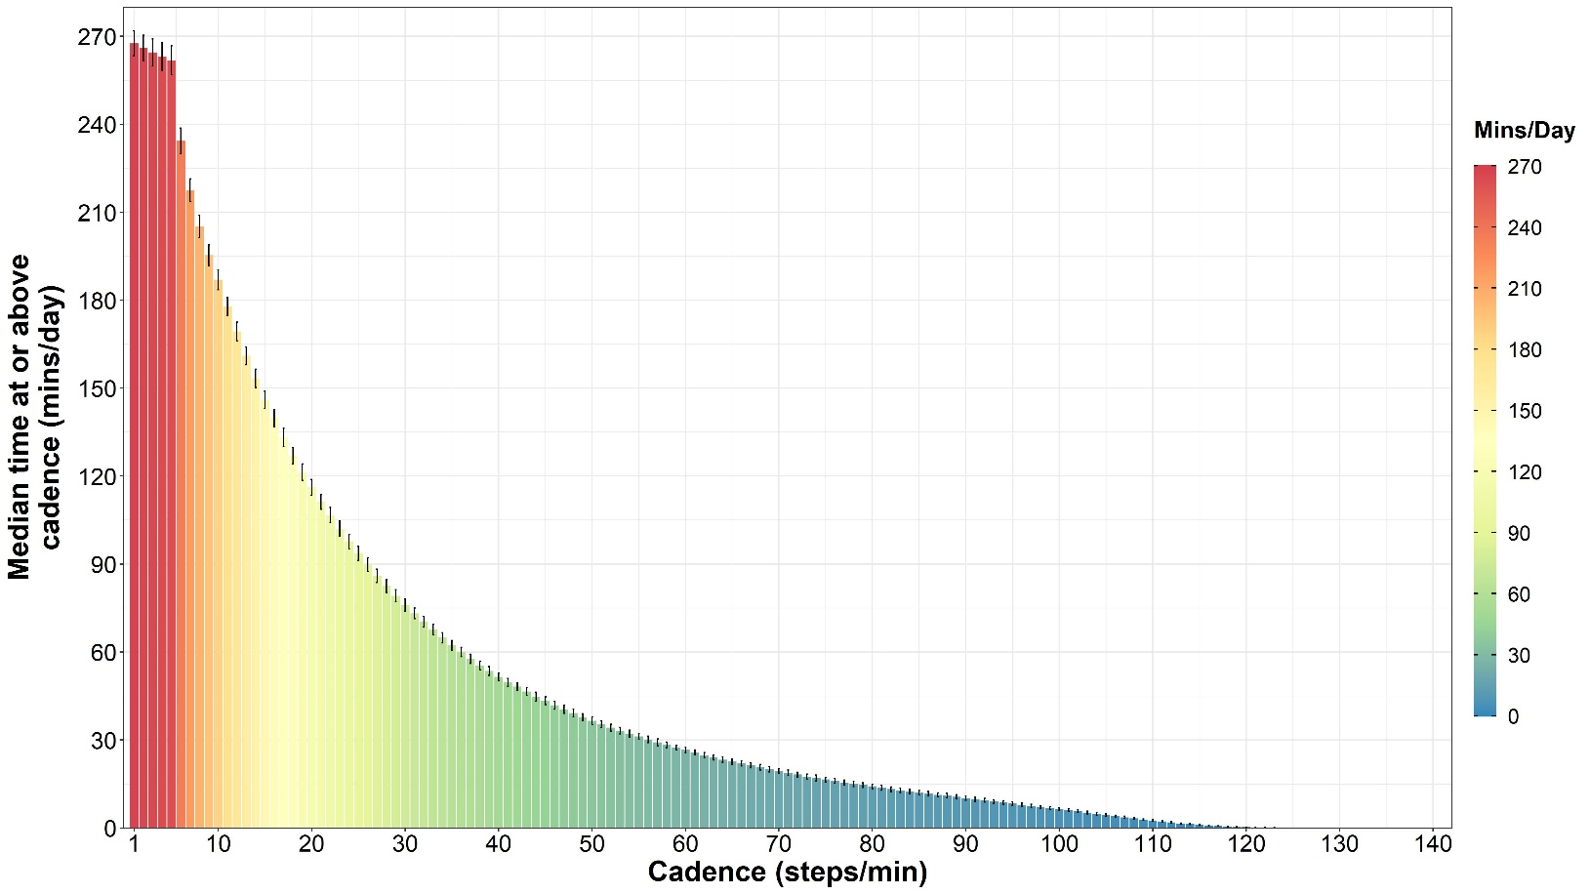
Distributions of Step-Based Metrics

Slide 47
Steps vs Counts
Correlations & Joint Distributions

Slide 48
Steps/Min Epoch-Level Distribution
Levels of Data:
Participant
(average over a week)
ID | Avg Steps/Day | Avg Counts/Day
50426 | 3655.0 | 84687.5
58250 | 8376.8 | 216146.5
60961 | 3822.6 | 112980.4
62276 | 6743.5 | 185972.5
72262 | 8980.8 | 226046.5
82707 | 19419.5 | 189763.667
ID | Avg Steps/Day | Avg Counts/Day
50426 | 3655.0 | 84687.5
58250 | 8376.8 | 216146.5
60961 | 3822.6 | 112980.4
62276 | 6743.5 | 185972.5
72262 | 8980.8 | 226046.5
82707 | 19419.5 | 189763.667
ID | Time | Steps | Counts
50426 | 7:23:00 | 0 | 12
50426 | 7:24:00 | 20 | 493
50426 | 7:25:00 | 111 | 3761
50426 | 7:26:00 | 2 | 77
50426 | 7:27:00 | 3 | 65
50426 | 7:28:00 | 73 | 640
Day
(sum or % of epochs)
Epoch
(1-min values)

Slide 49
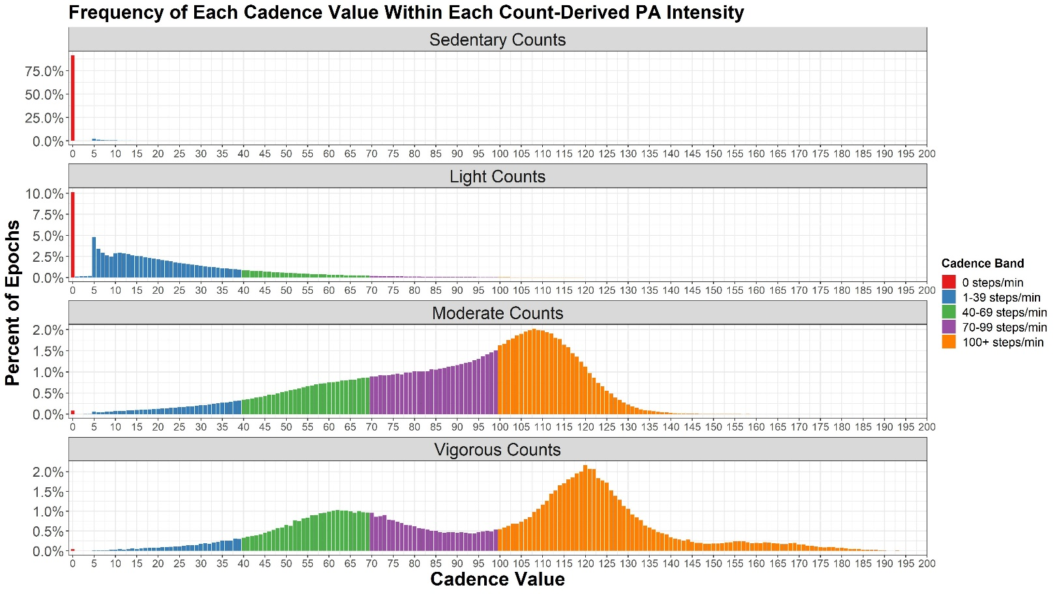


Steps/Min Epoch-Level Distribution
In epochs with counts <100 (sedentary),
~90% of step values were zero
Notes:
Light → some filter preventing 1-4 steps?

Slide 50
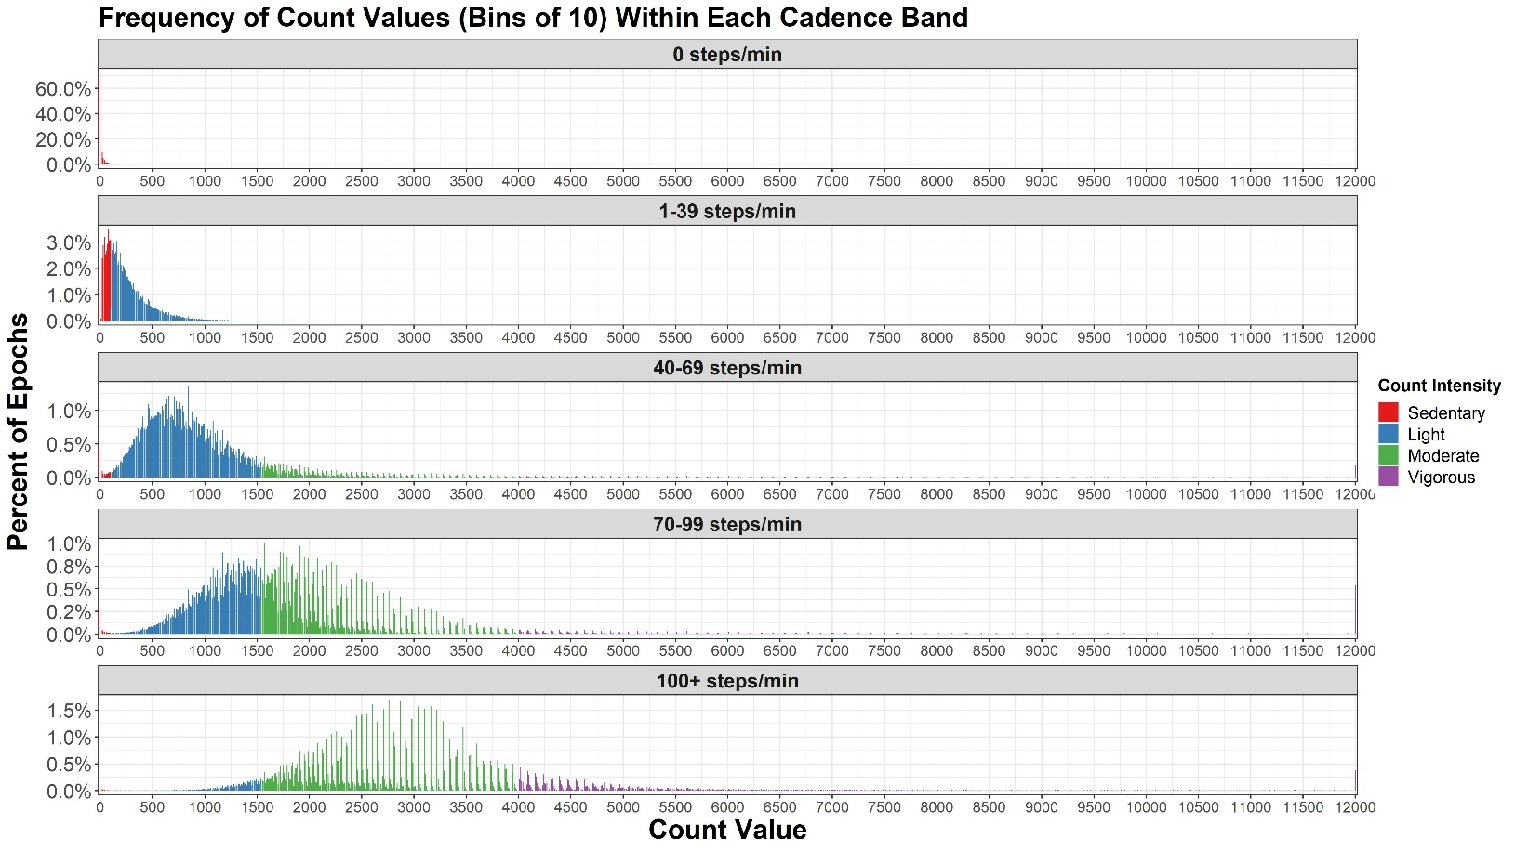
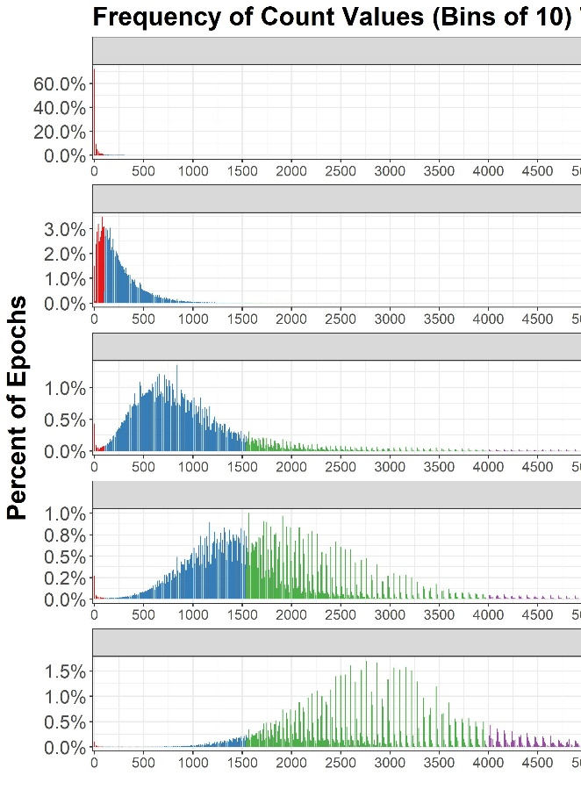
Counts/Min Epoch-Level Distribution
X
Notes:
Showing the full range
- Very few obs >5000

Slide 51

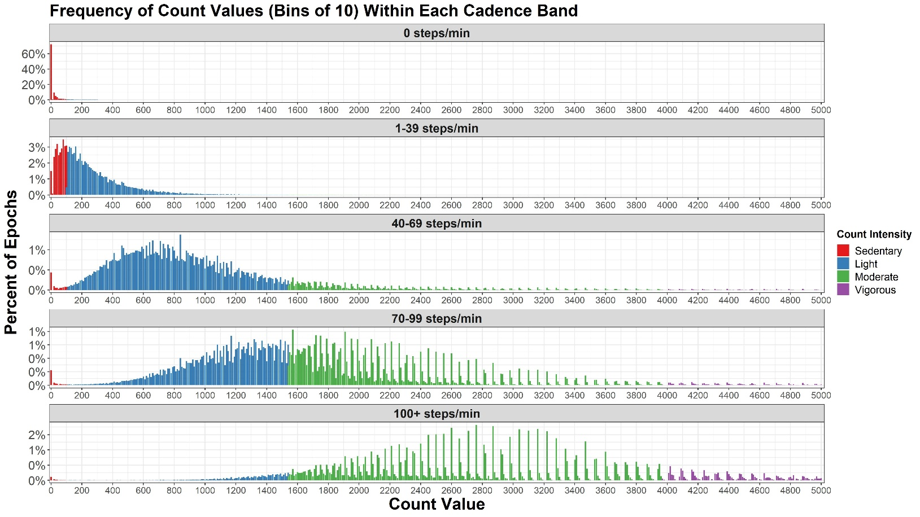
Counts/Min Epoch-Level Distribution
Notes:
Preference for certain count values has been reported by Kelly
Zero lines up well
1-39 – still a lot of sedentary
40-69 – get much more into light range
70-99 – looks half light half mod
100+ - moderate/vigorous

Slide 52
Participant-Level Distributions
Levels of Data:
Participant
(average over a week)
Similar
ID | Time | Steps | Counts
50426 | 7:23:00 | 0 | 12
50426 | 7:24:00 | 20 | 493
50426 | 7:25:00 | 111 | 3761
50426 | 7:26:00 | 2 | 77
50426 | 7:27:00 | 3 | 65
50426 | 7:28:00 | 73 | 640
Day
(sum or % of epochs)
ID | Avg Steps/Day | Avg Counts/Day
50426 | 3655.0 | 84687.5
58250 | 8376.8 | 216146.5
60961 | 3822.6 | 112980.4
62276 | 6743.5 | 185972.5
72262 | 8980.8 | 226046.5
82707 | 19419.5 | 189763.667
Epoch
(1-min values)
Distributions of epoch-level data

Slide 53
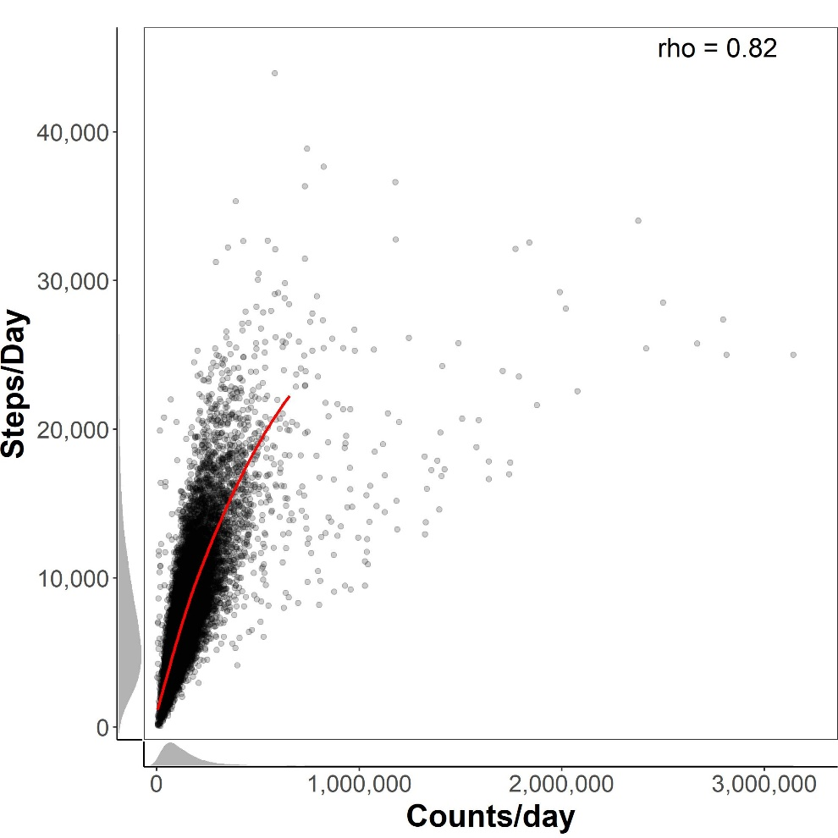
Step/Day vs Count-Based Metrics
Spearman correlation
LOESS cut at 99th percentile
Density (univariate)

Slide 54
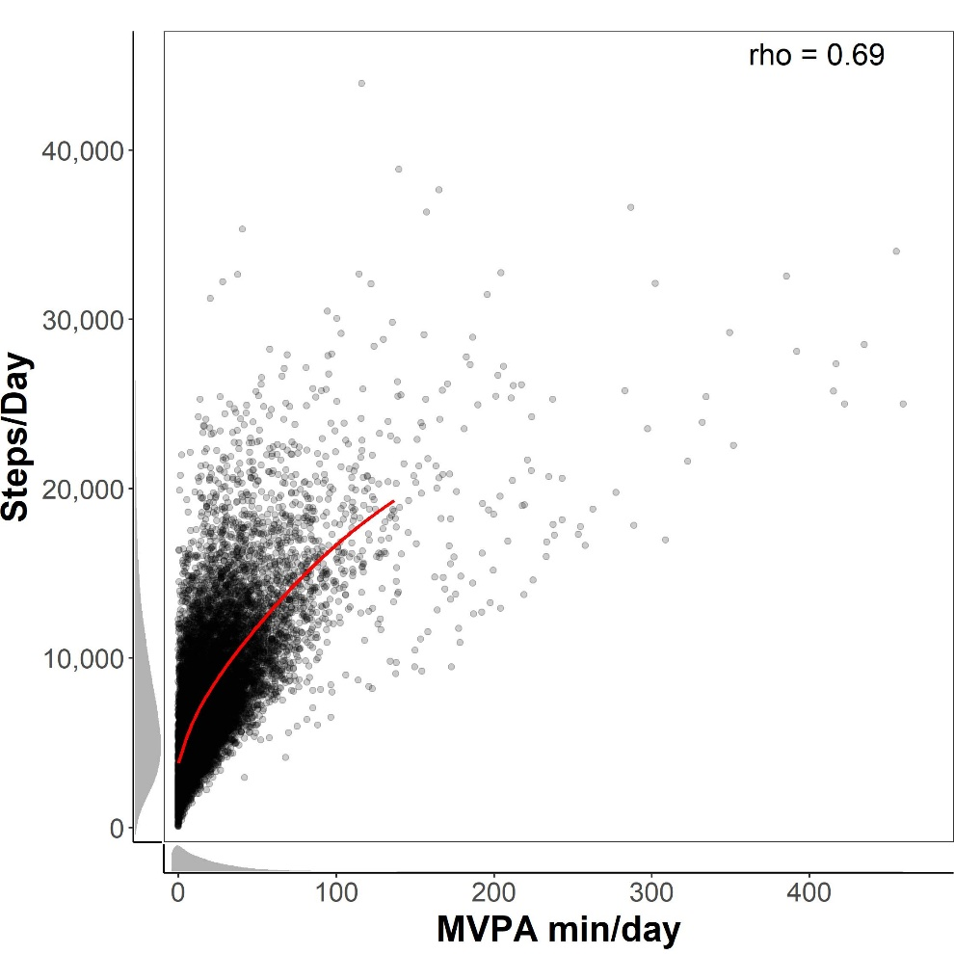

Step/Day vs Count-Based Metrics
Notes:
Weaker , Not all steps are MVPA
Some actually get little MVPA but high steps

Slide 55

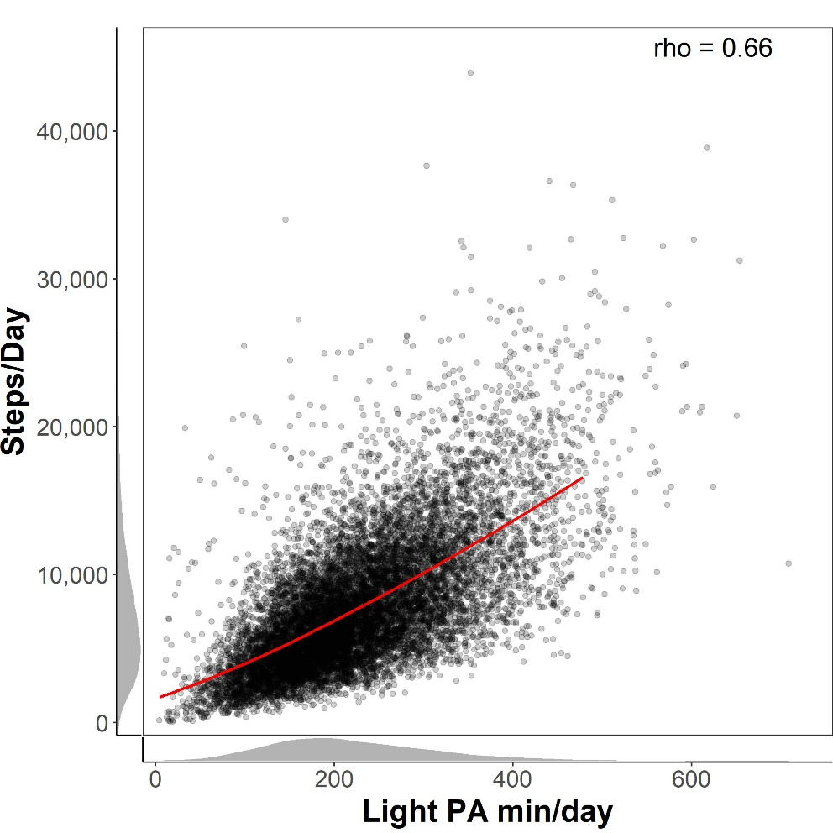
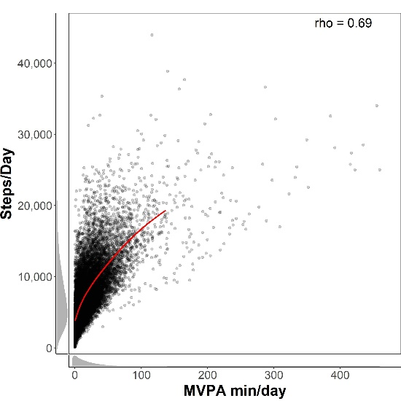
Step/Day vs Count-Based Metrics
Notes:
Light not as strong as counts/day
Similar strength as MVPA

Slide 56
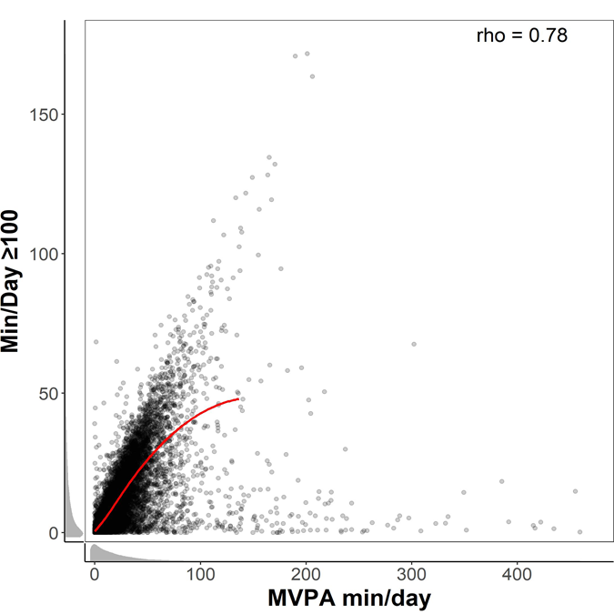

MVPA vs Step-Based Metrics
“Brisk walking”
Notes:
Stronger than steps/day
Some people get a fair amount of MVPA but little time above 100

Slide 57


MVPA vs Step-Based Metrics
≥“Purposeful walking”
Notes:
Above 40 stronger than steps/day, weaker than >100
But notice everyone getting MVPA still getting some time >40

Slide 58


MVPA vs Step-Based Metrics
Notes:
Stronger correlation than either

Slide 59


MVPA vs Step-Based Metrics
Peak-30 min cadence (steps/min)
Notes:
Peak-30 has a more normal distribution
Slightly weaker than 70 but not by much

Slide 60




Light PA vs Step-Based Metrics

Slide 61

TZC vs Count-Based Metrics
But…

Slide 62
TZC vs Count-Based Metrics
Wear time¹
Time at sedentary counts
Time at zero cadence (TZC)
rho =0.93
e.g., ¹Tudor-Locke, Johnson, & Katzmarzyk J Phys Act Health 2011

Slide 63


TZC vs Count-Based Metrics
r = 0.83

Slide 64
TZC vs Count-Based Metrics
Wear time
r =0.82
r =0.78
Time at sedentary counts
Time at zero cadence (TZC)
rho =0.93

Slide 65


TZC vs Count-Based Metrics
Adjusted for wear time using the residual method
(Willett & Stampfer Am J Epidemiol 1986)

Slide 66


Summary: Spearman Correlations (95% CIs)
Spearman Correlation
1.0
0.5
0.0
-0.5
-1.0
Notes:
Counts/day – strongest is steps/day
Makes sense
>40 very close behind
MVPA strongest with peak-30
Seems to not catch light intensity as much
Light instead corr w/ 1-39
Bouts with >100
Strongest of all is sed w/ TZC

Slide 67
Future Directions

Slide 68


Summary from today
Epoch-level joint distributions of steps and counts
Data quality checks
Sample descriptives
Correlations between step-based metrics & counts
Adjusting for wear time

Slide 69
Too much for one paper…
Step-Based Metrics in US Hispanic/Latino Adults: Results from HCHS/SOL
Epoch-level joint distributions of steps and counts
Sample descriptives
What do these metrics represent, more broadly?
Generalizability?
Correspondence with self-report
How do we communicate these metrics?
Correlations between step-based metrics & counts
How do we examine volume vs intensity?
Step-based metrics & meeting PA guidelines
Adjusting for wear time
Data quality checks
Where’s the code?

Slide 70
The Next ‘Step’
Purpose: To present and summarize evidence for informing the selection, interpretation, and analysis of step-based metrics
in epidemiological research, using data from two studies
Women’s Health Study (WHS) | HCHS/SOL
N = 16,741 | N = 12,750
Older women (mean [range] = 72 [62-101] years) | US Latino men and women (mean [range] = 41 [18-74] years)
ActiGraph GT3X+ | Actical version B-1
Specific aims: To...
Review, compare, and contrast various step-based metrics
Discuss and illustrate challenges related to cleaning, analyzing, and processing step data
Notes:
Idea is still under development

Slide 71
Motivation
Generalizability?
Review, compare, and contrast various step-based metrics
What do step-based metrics represent, more broadly?
How do we communicate these metrics?
Discuss and illustrate challenges related to cleaning, analyzing, and processing step data
Where’s the code?
Data quality checks
How do we examine volume vs intensity?
Adjusting for wear time

Slide 72
Aim 1: Motivation
Review, compare, and contrast various step-based metrics
What? Conceptually, supplemented by data
Why? To begin/add to the discussion of selection & interpretation
5
8
*Tudor-Locke et al. Br J Sports Med 2018

Slide 73
Aim 1: Motivation
22
*Tudor-Locke et al. Br J Sports Med 2018

Slide 74
Aim 1: Motivation

Slide 75
Motivation
Generalizability?
Review, compare, and contrast various step-based metrics
What do step-based metrics represent, more broadly?
How do we communicate these metrics?
Discuss and illustrate challenges related to cleaning, analyzing, and processing step data
Where’s the code?
Data quality checks
How do we examine volume vs intensity?
Adjusting for wear time

Slide 76



Aim 2
Discuss and illustrate challenges related to cleaning, analyzing, and processing step data
Data cleaning: application of a three phase framework¹
Screening phase - e.g., identifying outliers/inliers
Diagnostic phase - e.g., erroneous, suspect, or a true extreme
Treatment phase - i.e., correcting, deleting, or no change
Screening in SOL
Diagnosing/Treating in SOL
¹Van den Broeck et al. PloS Med 2005

Slide 77
Aim 2
Discuss and illustrate challenges related to cleaning, analyzing, and processing step data
Adjusting for wear time
How?
When?
b) Separating volume (steps/day) and intensity (steps/min)
How are they related?
What methods have been used?
Stratification → is positivity a potential concern?
e.g., can a participant in the lowest quartile of steps/day be in the highest quartile of time ≥ XX steps/min
Standardization → influence on step-based metric distributions?
Notes:
e.g., using percentage of wear time, the residual method, imputation, and other standardization methods

Slide 78

Aim 2
Discuss and illustrate challenges related to cleaning, analyzing, and processing step data
‘StepMetrics’ (future) R package
Flexible derivation of step-based metrics (SBM)
Accounting for wear time
Examining correlations between wear time and a SBM
Implementing methods for wear time adjustment
Data visualization
Data quality checks
Descriptive statistics
Include features relevant to epidemiological research
Efficiency
Accounting for survey designs and weights
Notes:
Wear time adjustment
Calculating SBMs
Data cleaning plots

Slide 79
Aim 2
Discuss and illustrate challenges related to cleaning, analyzing, and processing step data
‘StepMetrics’ (future) R package
Flexible derivation of step-based metrics (SBM)
Accounting for wear time
Data visualization
Data quality checks
Descriptive statistics
Include features relevant to epidemiological research
Efficiency
Accounting for survey designs and weights

Slide 80


Dunning-Kruger Effect

Slide 81







Building on Prior Work
Med Sci Sports Exerc 2016
Methods Inf Med 2016

Slide 82

Acknowledgements
Kelly Evenson, PhD
Carmen Cuthbertson, PhD
Daniela Sotres-Alvarez, PhD
I-Min Lee, PhD
Molly Wen, Applications Specialist
Catrine Tudor-Locke, PhD
Support from T32 Cardiovascular Epidemiology Training Grant (NRSA:T32-HL007055-44)

Slide 83

Thank You!
Questions?
Comments?
Feedback?

Slide 84
My Questions
Strategies for computational efficiency
Applications to creating R packages
‘data.table’ package?
Need for a new package for steps to include functions for things like wear time and combining data?
How is data usually stored?
e.g., individual files for each person or long format
Use of other functions/modified source code in R packages
General tips? What advice had you heard about creating R packages that you undervalued?
# dpylr
newdata <- mutate(data, hr = min*60)
# data.table
data[, hr := min*60]

Slide 85
Supplemental Slides

Slide 86
Peak 30 vs Count-Based Metrics
What is peak 30-min cadence?
Average steps/min recorded for the 30 highest, but not necessarily consecutive, minutes in a day
Additional Notes
Units are steps/min
Influenced by:^{1,2}
Intensity - highest daily cadence values accumulated
Duration - ‘persistence’ of behavior on that day
Averaged over 30 minutes
Consistency - habitual regularity of this behavior pattern
Averaged across ≥ 3 days
¹Tudor-Locke et al. Br J Sports Med 2018
²Kang et al. J Phys Act Health 2016

Slide 87

Correlations Summary (with self-report)

Slide 88
Accounting for Wear Time

Slide 89

Total Wear Time
Total time = time at zero cadence (TZC)
+ time at 1-69 steps/min + time ≥70 steps/min

Slide 90
Accounting for Wear Time
Approaches
Use percent wear time (e.g., % wear time at ≥70 steps/min)
Difficult to interpret
Convert percent wear to minutes/day
Using residual from regressing time at cadence on wear time¹
Fit model e.g., TZC_{pred} = β ∗ wear time
Calculate residual residual = TZC_{actual} - TZC_{pred}
Use model to estimate → E(TZC|16hrs wear) = β ∗ 16hrs
For each participant, calculate:
TZC|16hrs wear = E(TZC|16hrs wear) + residual
¹Qi et al. Circulation 2015
Notes:
For each participant

Slide 91

Accounting for Wear Time
3 hrs above expected TZC given 20 hrs of wear

Slide 92
Accounting for Wear Time
3 hrs above expected TZC given 16 hrs of wear

Slide 93


Residual from Regression Method
Also included site in regression:
Sedentary time ~ Wear time + Site + Wear time*Site

Slide 94

Residual from Regression Method

Slide 95



Apply to which step-based metrics?

